Slide 1
Beers and Breweries Analysis
MSDS 6306: Doing Data Science
Case Study1 by: Paritosh Rai
YouTube Link
GitHub Link

Slide 2
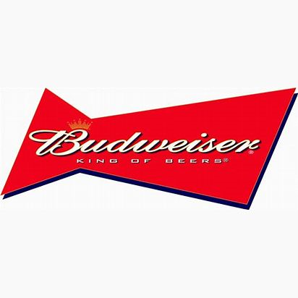
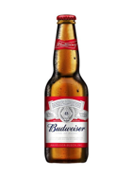
Introduction
Team reviewed the database of 2410 US craft Beer and Breweries:
Looked at number of Breweries and their locations (States)
Reviewed the alcohol content (ABV) and bitterness (IBU) of beers across the state
Identified the beer with maximum alcoholic content (ABV) and Beer with maximum bitterness (IBU)
Summarized the details of ABV(Alcohol by volume)

Slide 3
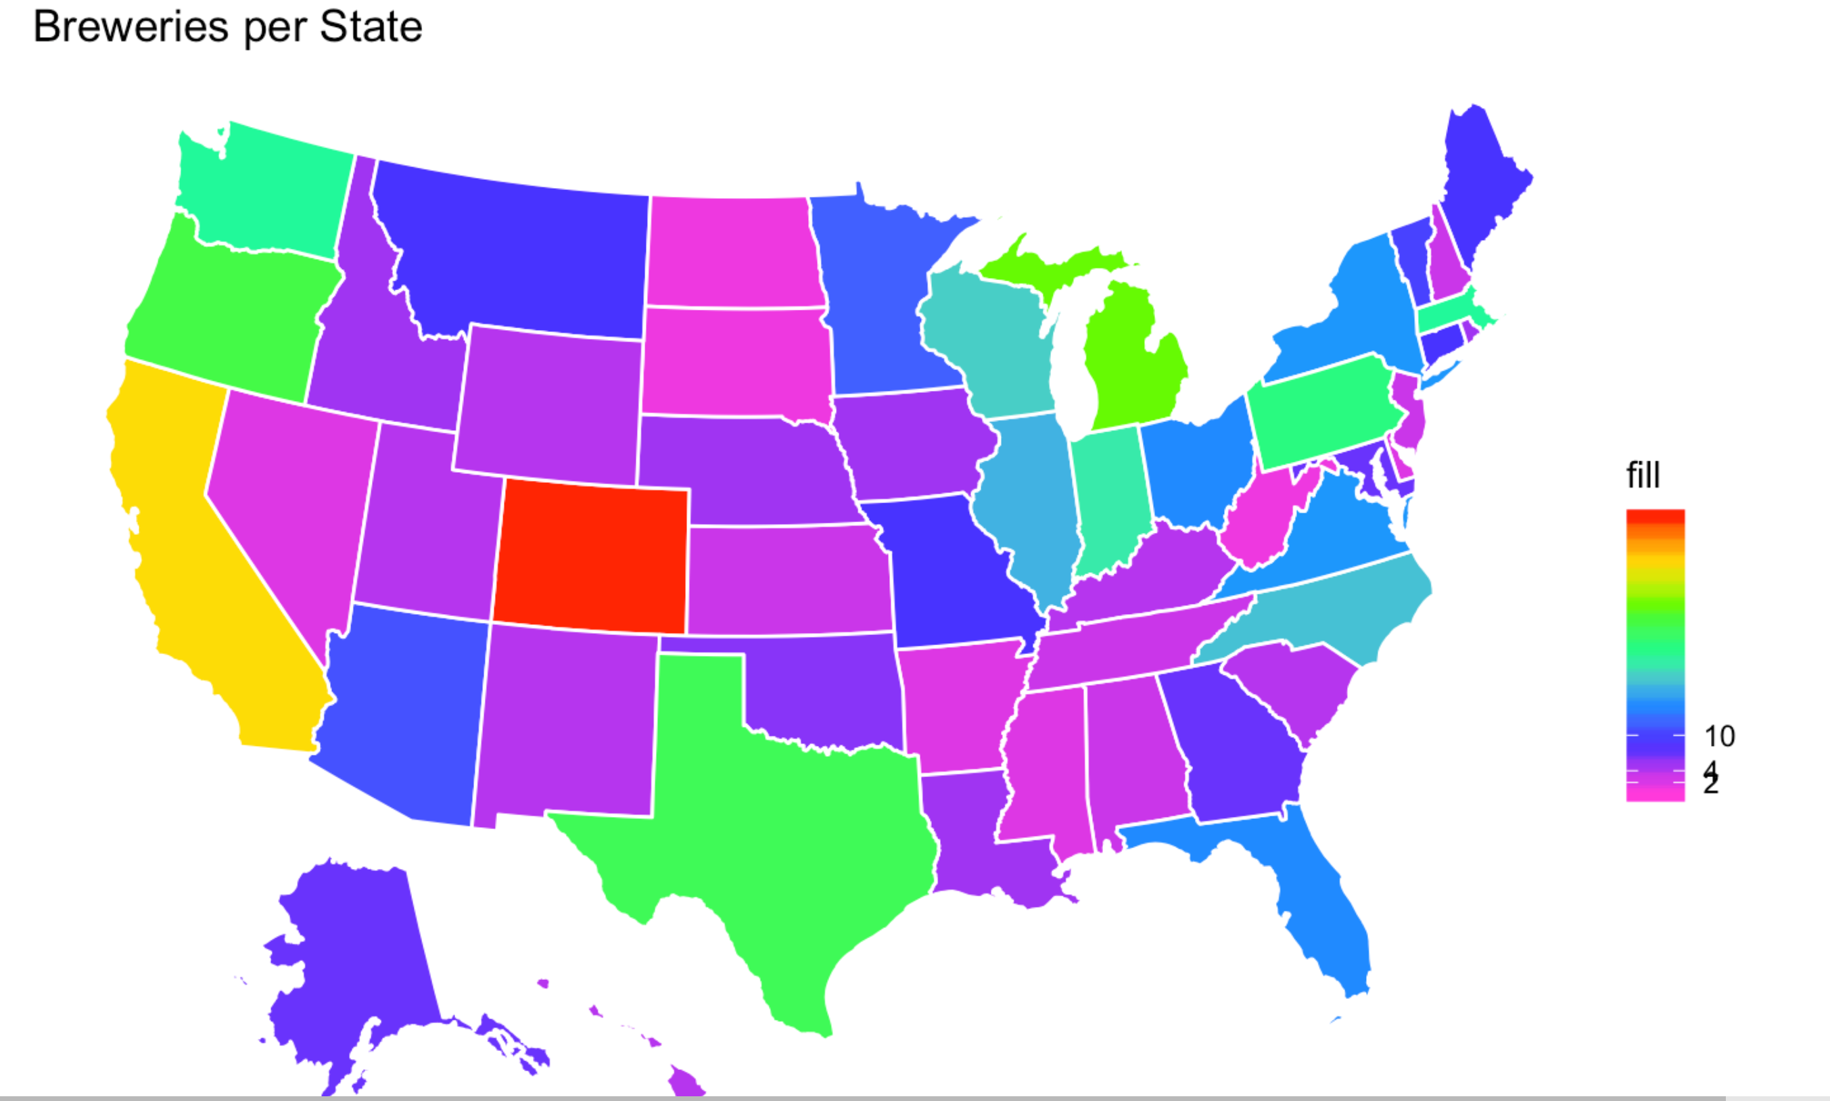
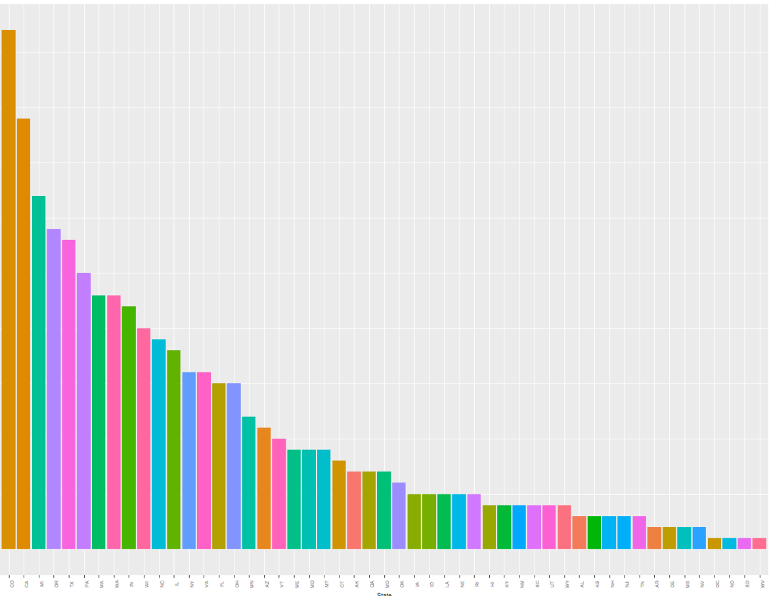
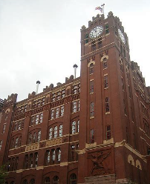
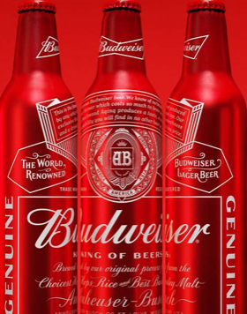
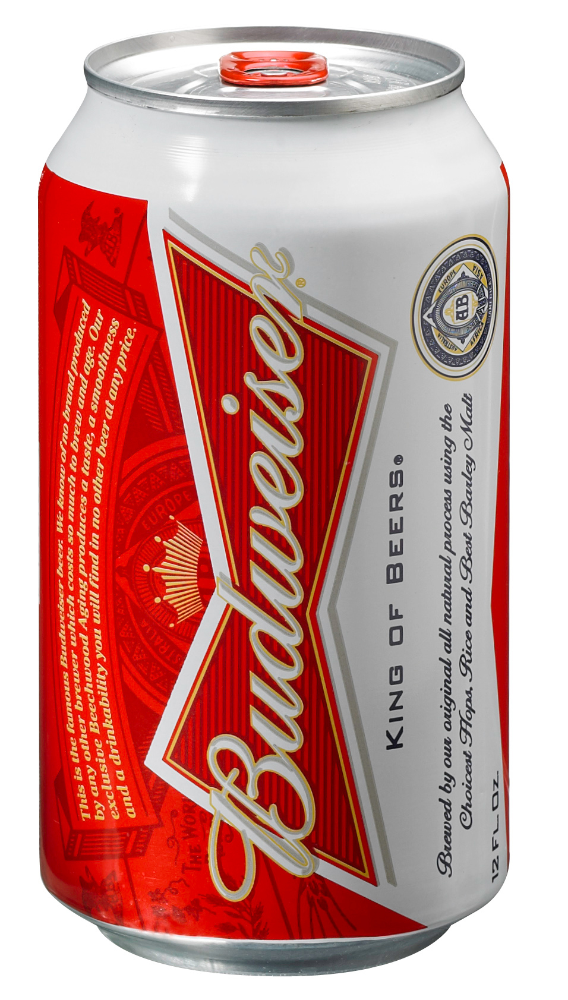
Breweries per States
Distribution of Breweries Across US States
Max number of Breweries are in Colorado (47)
Min number of Breweries are in DC(1),ND(1),SD(1) and WV(1)
MO ranks 21 with 9 Breweries (HQ of Budweiser)
80% of Breweries are located in ~40% of states(22 of 51 states)
TX holds 5th rank with 28 Breweries
Distribution of Breweries counts
Across US States

Slide 4
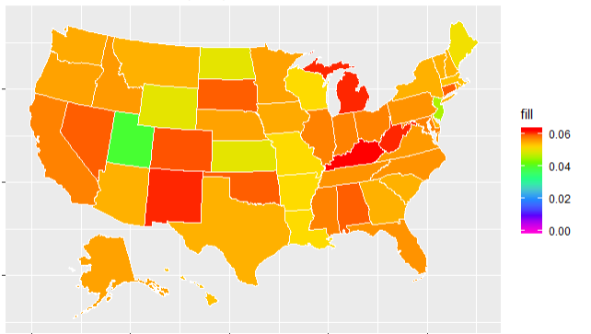
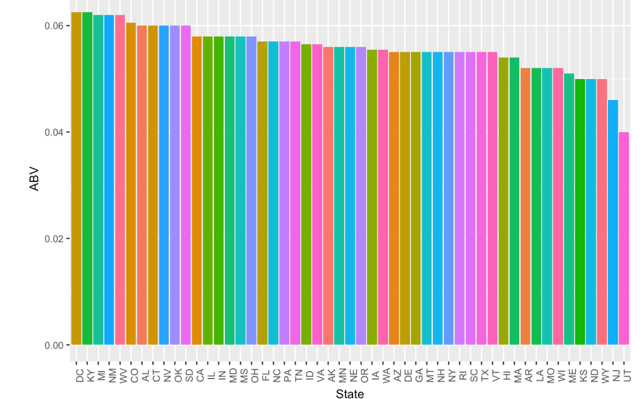
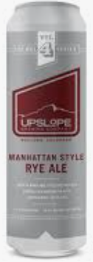
Median Alcohol Content of Beers (ABV)
State with highest median ABV is DC (6.25%)
State with lowest median ABV is UT (4.00%)
MO ranks 44 with 5.2% ABV (HQ of Budweiser)
Median range across US is 2.25%
TX holds 38 rank with 5.5% of ABV
Lee Hill Series (CO Med:6.05%) has highest ABV (12.8%)
Scotty K NA of CA (CA Med: 5.8%)has lowest ABV (0.1%)
ABV: Alcohol by Volume
Median ABV across US States
Median ABV of Beer across US States

Slide 5
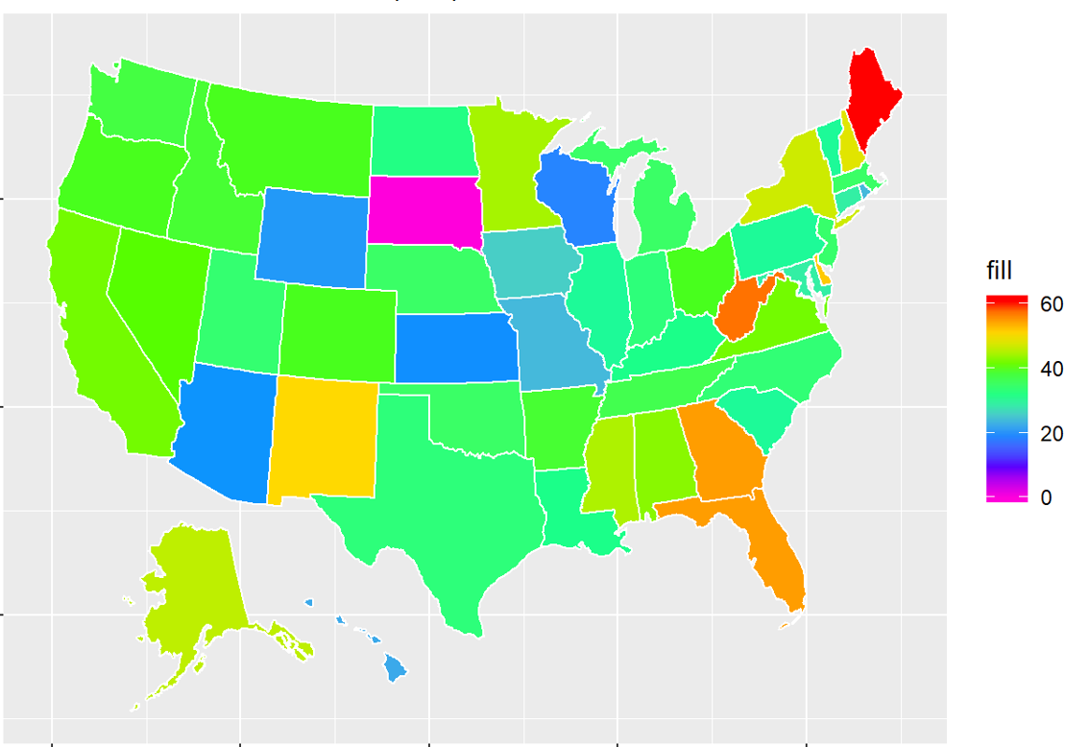
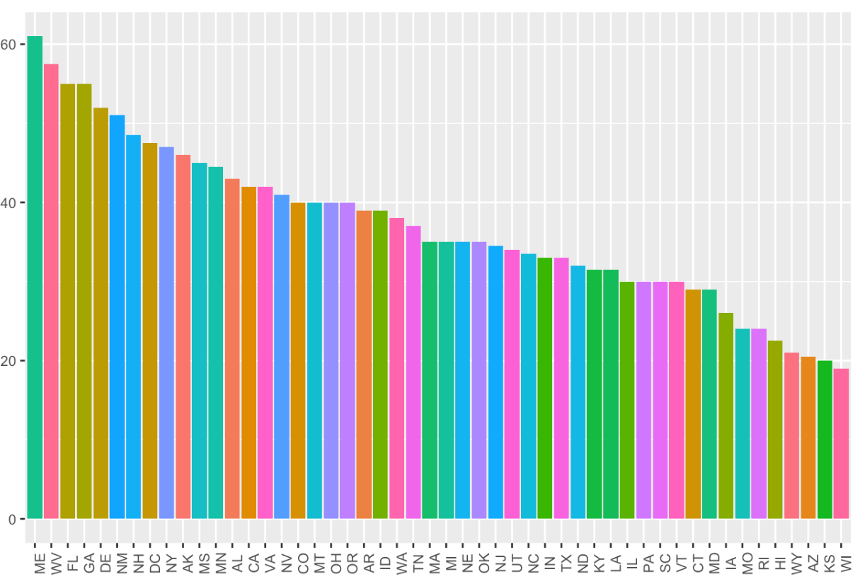

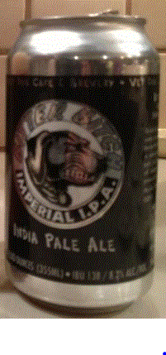
Median of International Bitterness Unit of Beers (IBU)
State with highest median IBU is ME (61)
State with lowest median IBU is WI (19)
MO ranks 44 with 24 IBU (HQ of Budweiser)
Median IBU range across US is 42
TX holds 33 rank with 33 with 33 IBU
Bitter Bitch Imperial of OR (OR Med:40) has highest IBU (138)
Summer Solstice of CA (CA Med: 42) has lowest IBU (4)
Median IBU across US States
Median IBU of Beer across US States

Slide 6
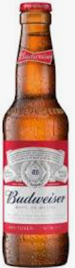
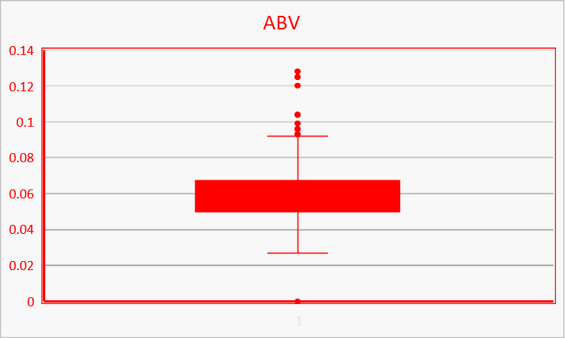
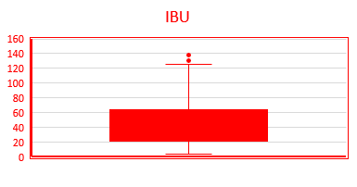
Summary of ABV and IBU
ABV Summary
IBU Summary
Measure | Value
Min. | 0.001
1st Qu. | 0.05
Median | 0.056
3rd Qu. | 0.067
Max. | 0.128
NA’s | 62
Mean | 0.059773
Measure | Value
Min. | 4.00000
1st Qu. | 21.00000
Median | 35.00000
3rd Qu. | 64.00000
Max. | 138.00000
NA’s | 1005.00000
Mean | 42.71317
ABV
IBU

Slide 7
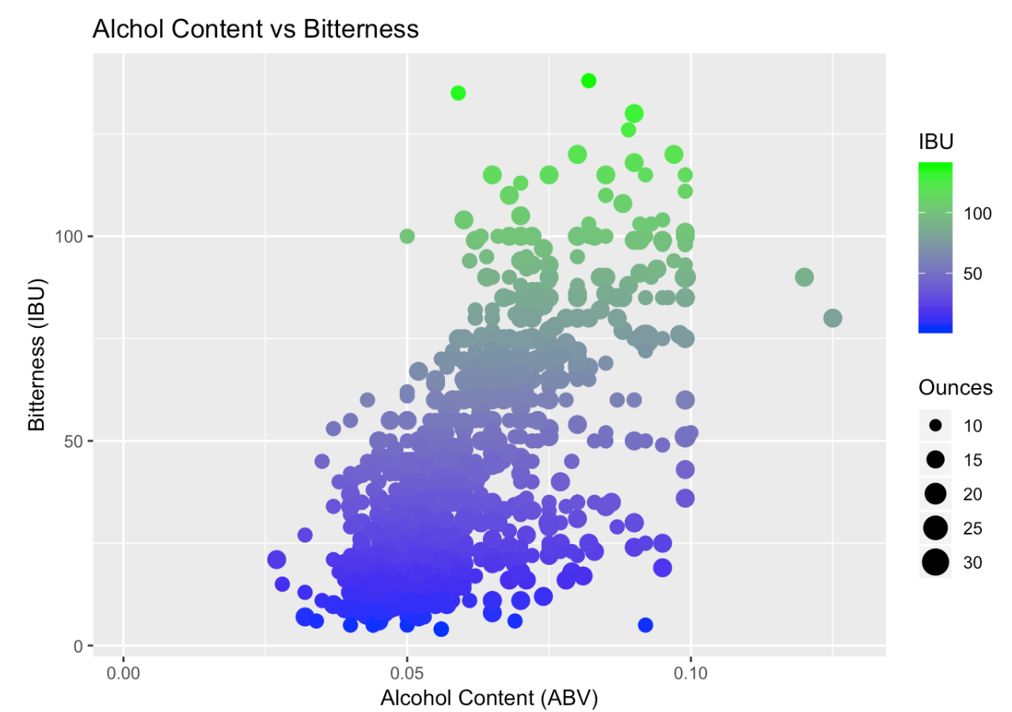
ABV vs. IBU
ABV and IBU Matrix
0
26
0
100
Bitterness (IBU)
8
432
2
50
383
554
0
0.05
0.10
Alcohol Content (ABV)
As ABV increase bitterness is predicted to increase
2/3 of beers are with low bitterness (<50)
Only 2% of beers are with high bitterness
Beers have less than 10% ABV
30% of beers are with medium bitterness and ABV

Slide 8
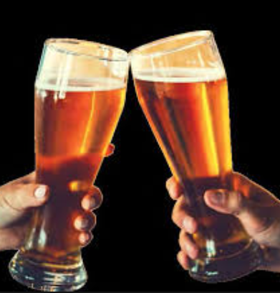
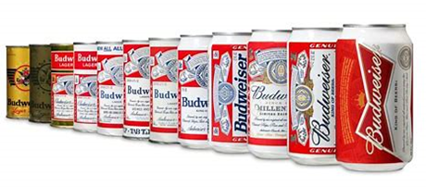
Conclusion
80% of Breweries are in 40% of states: Focus on 40% of states for the beer procurement.
Median ABV is almost flat across the states however ABV ranges from 0.1% to 12.8%.
Median IBU varies among the states however IBU ranges from 4 to 138.
Keep focus on beer with low bitterness (<50), 2/3 of beers are of low bitterness.
High alcohol content (ABV) is not driver for beers.
Thanks for the Opportunity

